Slide 1
﻿Decision tree and random forest models for outcome prediction in antibody incompatible kidney transplantation
Biomedical Signal Processing and Control
Available online 9 February 2017
﻿Torgyn Shaikhina, Dave Lowe, Sunil Daga, David Briggs, Robert Higgins ,Natasha Khovanova
Presentation by Xiaopeng Jiang

Slide 2
Highlights
Explored the potential of Decision Tree (DT) and Random Forest (RF) classification models that predict early antibody-incompatible kidney transplant rejection.
The models were trained on a small clinical dataset of 80 samples of pre-transplant characteristics.
Decision Tree and Random Forest classifiers achieved 85% accuracy.
The models identified key risk factors, including specific IgG subclass levels.
Notes:
Immunoglobulin G

Slide 3
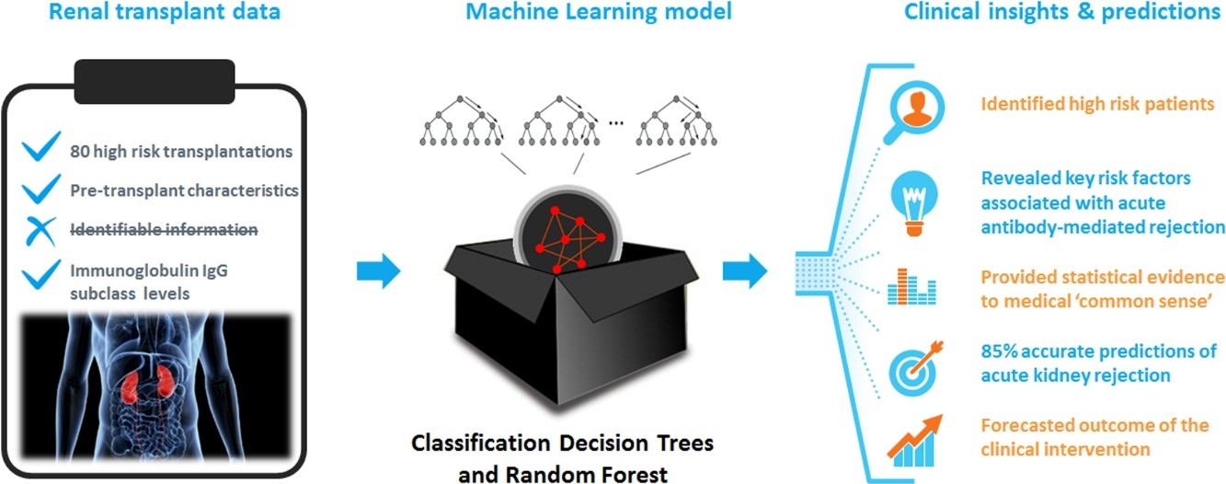
Graphical Abstract

Slide 4
Background
DTs are particularly well suited for clinical classification task. DTs are easy to interpret by non-statistician and are intuitive to follow. They cope with missing values and are able to combine different data types into a single model, whilst also performing an automatic principal feature selection
Organ transplantation can dramatically improve patients’ quality of life, often offering the only solution for their survival.
This area, however, does not generate large patient datasets due to the severity of accompanying diseases and the complexity of clinical operations, thus preventing wide application of ML techniques for the prediction of transplant outcomes.

Slide 5
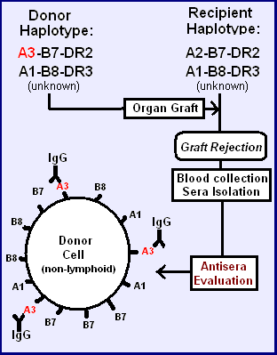
Background
For a successful transplantation outcome, the recipient and donor should be matched for tissue proteins called human leukocyte antigen (HLA).
HLA mismatches between the transplant recipient and their donor may cause the development of antibodies against HLA, which can subsequently lead to transplant failure.
Antibody incompatible transplantation (AIT), now well-established, allows one to decrease DSA (donor-specific antibodies) levels prior to transplantation and operate on patients with HLA mismatches. However, complete elimination of DSAs and immunological memory is not practical.
Among isotypes of HLA antibodies, Immunoglobulin IgG is predominant and is considered to be the agent of humoral rejection.
A simple example of HLA antigen causing rejection
A1, A2, B7, B8 do not cause reaction because they are in both donor and recipient, DR2 and DR3 are found on lymphoid cells
Notes:
For a successful transplantation outcome, the recipient and donor should be matched for tissue proteins called human leukocyteantigen (HLA). HLA mismatches between the transplant recipient and their donor may cause the development of antibodies aginst HLA, which can subsequently lead to transplant failure and endanger a future transplant if it has an HLA type reactive with the antibodies. HLA antibodies can also be stimulated by pregnancy and blood transfusion. Patients with preformed HLA donor-specific antibodies (DSAs) have longer waiting times for surgery or are unable to receive a renal transplant. Antibody incompatible transplantation (AIT), now well-established [21], [22], allows one to decrease DSA levels prior to transplantation and operate on patients with HLA mismatches. However, above 40% of kidneys still experience a rejection episode, because complete elimination of DSAs and immunological memory is not practical. Neither types of harmful DSAs nor their acceptable levels before transplantation are known. Among isotypes of HLA antibodies, Immunoglobulin IgG is predominant and is considered to be the agent of humoral rejection. Its four subclasses (IgG1-4) exhibit functional differences and associate with differences in clinical outcome [23]. Our earlier work using conventional statistical analysis based on logistic regression revealed that IgG4 subclass presents a significant risk factor for ABMR in AIT [23].

Slide 6
Other Studies
Notes:
the further into the future the forecast scope is, the better its accuracy – appears unintuitive to those working with real-world forecasts. This phenomenon can be explained in part by the way the model accuracies were measured and how this was influenced by the reduced follow-up and class imbalance dynamics over the years as more allografts fail.
which again can be attributed to high class imbalance between DGF + ve (12.5%) and DGF-ve samples.
The ratio of the number of observations x to the number of predictor features p was greater than 20 in the four above applications. Such ratio may not, however, be feasible for smaller transplant units wishing to analyse their samples without having to wait for decades until enough operations are conducted. In such cases, when x/p < 10, ML modelling faces the challenges of volatility of outcomes among models of the same design due to insufficient data.
high variablitity among the models of the same design is characterisic of small-data applications of ML algorithms which have embedded degrees of randomness in their training and initialisation routines, even for deep learning models. Large descripances in predictions based on small datasets are common for other ML approaches. it is essential to develop methods that would cope with the limited data size.

Slide 7
Objectives
Small-data applications of ML models for classification tasks. for early prediction of acute antibody-mediated rejection (ABMR) in kidney transplantation based on pre-operative (baseline) clinical indicators.
Confirm the key risk factors associated with early (within first 30 days following the transplantation) ABMR and to find baseline levels of DSAs (donor-specific antibodies) for safe transplantation
Produce an accurate patient-specific predictive model using DT and RF-based methods in order to support clinical decision-making

Slide 8
Data
80 patients who received HLA incompatible renal allografts between 2003 and 2012 (49 female and 31 male patients with average age 41.8 ± 11.6 years (range = 18–68 years)).
14 input feature set measured before transplantation for the model:•
7 continuous: highest IgG DSA MFI level, patient’s age, years on dialysis (ESRD duration), and 4 total IgG subclass (1–4) MFI levels
4 categorical: cytometery cross-match (1 = bead, 2 = flow or 3 = CDC), total number of HLA mismatches between donor and recipient (0–6), the number of class II HLA-DR mismatches (0–2), and the number of previous transplants (0–2),
3 binary: gender (male/female), the presence of both HLA Class I and Class II DSA (yes/no), and a marker of whether the transplant was from live or deceased donor.
Notes:
Antibody levels were measured in serum taken before antibody reduction treatments using a fluorescence immunoassay and are given as Median Fluorescence Intensity (MFI)
When your kidneys fail, dialysis keeps your body in balance by: removing waste, salt and extra water to prevent them from building up in the body.
Cytometry is the measurement of the characteristics of cells.

Slide 9
Data
The output, two-class binary variable, ABMR + ve the early rejection of kidney (class ‘1′), and ABMR-ve rejection-free outcome (class ‘0′).
Data from 60 patients, sampled at random, were used for model training and the remaining 20 samples were reserved for independent tests.
The data were well balanced (46 rejection and 34 rejection-free ), but contained 3 samples with partially missing fields.

Slide 10
Decision Tree (DT)
Standard CART algorithm implemented using MATLAB
The split optimisation criterion used in this DT model is the Gini’s Diversity Index (GDI), which is a measure of node impurity.
The following additional constraints were imposed on the DT size: minimum 10 observations for the node to become a branch node and at least 1 observation per a leaf node.
The experiment with DT was repeated 600 times and each time a different data subset was sampled out of the original samples. It was expected to observe high volatility among the performance of those 600 DTs.
Pruning is achieved by removing the nodes that have least effect on the overall classification performance.
Notes:
Pruning?
Reduced-Error Pruning: each node is replaced with its most popular class. If the prediction accuracy is not affected then the change is kept. While somewhat naive, reduced error pruning has the advantage of simplicity and speed.
Pessimistic Pruning
Cost-Complexity Pruning

Slide 11
Random Forest (RF)
This aggregate vote of several DTs is inherently less noisy and less susceptible to outliers than a single DT output, which mitigates the volatility due to small data and improves the robustness of predictions
The RF was comprised of 600 fully grown trees. This number of trees was selected to correspond to the number of individual DTs considered.
The experiment with RF was repeated 10 times to monitor for the variance due to small data.
Minimum number of samples per leaf node was increased to 3 in order to compensate for otherwise very large trees grown without pruning
Only a subset of 14 original input parameters, i.e. 9 predictor variables, was used. statistically insignificant input parameters were excluded. Out of the nine, six predictor variables were sampled at random for each partial-feature tree in the RF.
Variable importance scores for RF was computed through permutation test.
Notes:
﻿Suppose the number of training records is N. Randomly pick records N times with replacement (repeatedly picking the same record is allowed).
﻿Suppose the number of attributes in each training record is M. When splitting each node, we randomly pick attributes and examine M each picked attribute.

Slide 12
Results - ﻿Decision Tree (DT) model

Slide 13
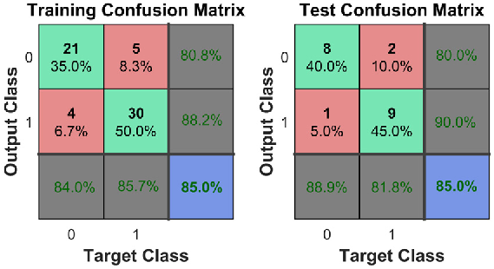
Results - ﻿Decision Tree (DT) model
The green squares correspond to TP and TN values, and the red squares represent FP and FN values. The four grey squares (from the top right, clockwise) represent the NPV, PPV (or precision), Sensitivity and Specificity. The blue square provides the overall Correct Classification Rate, C.
Notes:
﻿Correct classification rate, C, measures the proportion of correctly identified observations of both classes: C = (TP + TN)/n
Negative predictive value, NPV = TN/(TN + FN)
Positive predictive value (or precision), PPV = TP/(TP + FP)
Sensitivity (or recall, or TP rate), Sn, measures the proportion of positives that are correctly identified as such: Sn = TP/(TP + FN)
Specificity (or TN rate), Sp, measures the proportion of negatives that are correctly identified as such: Sp = TN/(TN + FP)

Slide 14
Results - ﻿Decision Tree (DT) model
﻿ AUC_{train} = 0.849
﻿AUC_{test} = 0.854

Slide 15
Results - ﻿Decision Tree (DT) model
Considerable volatility in performance and structure could be observed among the 600 DTs
14 out of 600 DTs used the same 6 variables for classification
Those 14 DTs based on the 6 variables identified in our DT model have a significantly higher predictive power(p < 0.002).
Wilcoxon rank sum test for median C based on 600 DTs and on the subset of DTs with repeating pattern. The DTs are of identical training parameters and design and only vary in the split between training and testing subsets.

Slide 16
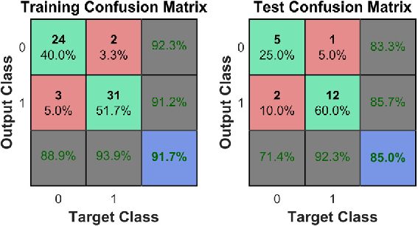
Results - Random Forest (RF) model

Slide 17
Results - Random Forest (RF) model
﻿ AUC_{train} = 0.914
﻿AUC_{test} = 0.819

Slide 18
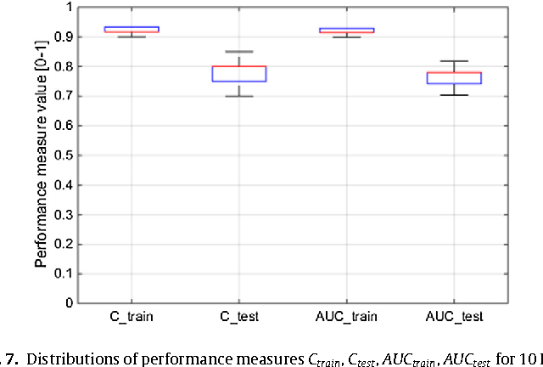
Results - Random Forest (RF) model
Experiment with RF was repeated 10 times in order to determine whether the consistency improved compared to the DT model. The results showed significantly reduced variance (σ = 0.002), and overall consistently high performance

Slide 19
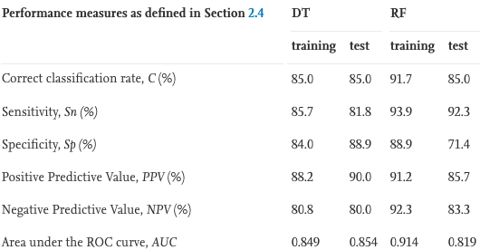
Results – DT vs RF

Slide 20
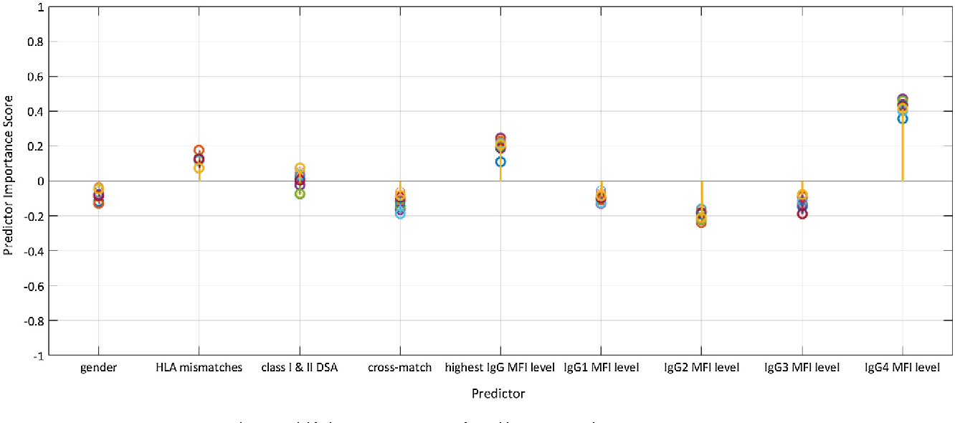
Results – Predictors
IgG4 is a key risk factor in kidney rejection in early post-transplant period

Slide 21
Discussion
The proposed models outperform previous models reviewed.
The superiority of the DT model is that it was also able to determine the level of antibodies associated with ABMR, which conventional statistical methods were unable to provide.
The RF model provides an extension to the DT model with the purpose of improving the robustness of the classification tool. A RF is so-called black-box model and less interpretable than DT, but allows for better consistency of results and robustness of predictions.
When used for clinical decision support, our models can provide a simulation tool to explore various clinical scenarios and identify patients at risk of ABMR prior to the operation, and thus leaving more time to make essential adjustment to treatment.
This single-centre study may not generalise on a larger population in and outside of the United Kingdom.

Slide 22
Conclusions
Graphical and easily-interpretable DT model based on14 clinical baseline characteristics of a small dataset of 80 samples revealed that the highest MFI DSA levels, the total IgG4 subclass MFI and the number of HLA mismatches are the highest discriminating factors between ABMR + ve and ABMR-ve patients.
Patients with (a) the highest MFI DSA levels below 1062 belong to the ABMR-ve group (rejection rate of 0%), while those with (b) the highest MFI DSA levels ≥1062 AND the total IgG4 subclass MFI level ≥80 have a high likelihood of early ABMR (rejection rate of 85%). Similarly, patients in (b) with 4 or 5 HLA mismatches are likely to develop ABMR (rejection rate of 85%).
RF model of 600 bagged DTs, which provided a robust classification with 85% accurate predictions in determining the acute ABMR of kidney transplants for each individual patient characterised by the presence of DSAs with high MFI levels, high IgG4 subclass MFI levels and a large number of HLA mismatches.

Slide 23
Thank you.

